Slide 1



Kinematics Analysis of 6 Degrees of Freedom Robotic Arm
By Mojahed Nour– July 27, 2020

Slide 2
CONTENTS
Kinematics Analysis of 6 Degrees of Freedom
01
Definition
02
AIM
03
Technique
04
References

Slide 3
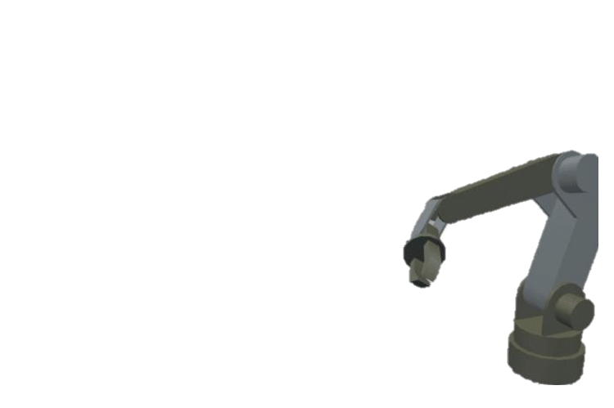
01
Kinematics Analysis of 6 Degrees of Freedom
What Is Kinematics Analysis?
The kinematics problem is related to finding the transformation from the Cartesian space to the joint space and vice versa. The solutions of the kinematics problem of any robot manipulator have two types;.
The forward kinematic:
When all joints are known the forward kinematic will determine the Cartesian space, or where the manipulator arm will be.
II. The inverse kinematics:
In the inverse kinematic the calculations of all joints is done if the desired position and orientation of the end- effectors is determined, that means by the inverse kinematic the robotic arm joint space angles will be calculated

Slide 4
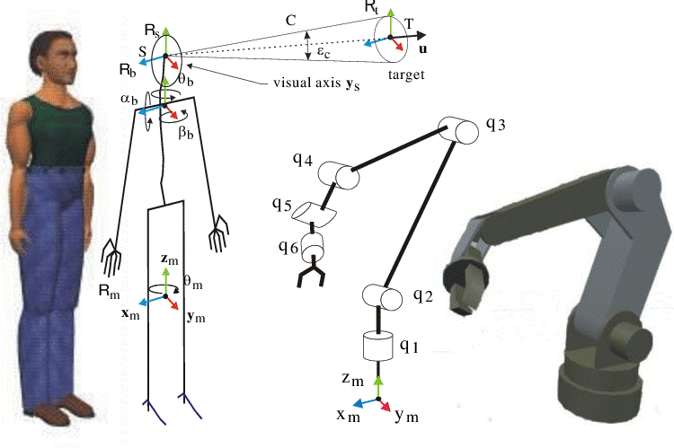
02
THE AIM
What is the purpose of this task ?
The aim of this study is to analyze the robot arm kinematics which is very important for the movement of all robotic joints.

Slide 5
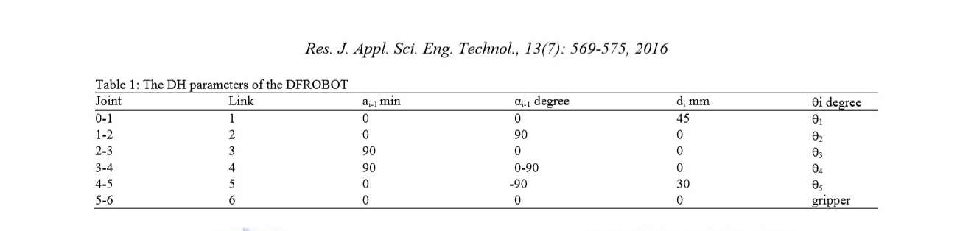
03
The technique
FORWARD KINEMATICS
The joint variables of the robot are given to determine the position and orientation effector.
Assignments of joints and all parameters used to define the robot frames can be defined by using the DH parameters table explained by Tahseen (2013)
Table 1 shows the related six joints parameters of the robotic arm ROB0036 manipulator in order to find the position and orientation of the rigid body which is useful for obtaining the composition of coordinate transformations

Slide 6
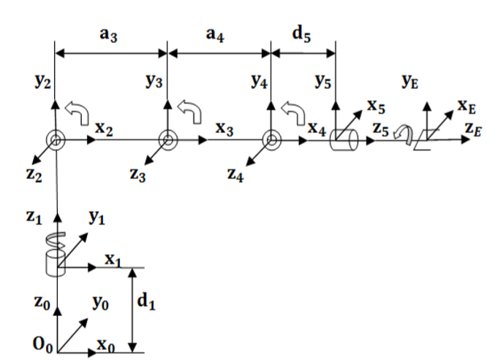
03
The technique
All joints as revolute. The main features of this kind: base rotation, single plane shoulder, elbow, wrist motion, functional gripper and optional wrist rotate. The kinematic modeling requires the solutions of the forward and inverse kinematics of the manipulator the link parameters are needed for the two solutions shown in the block diagram

Slide 7
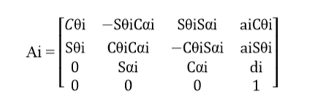
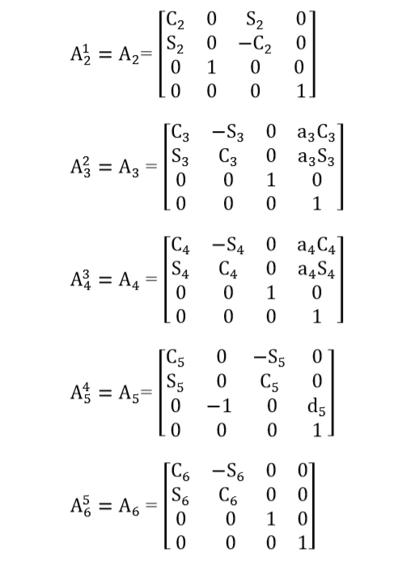

03
The technique
Forward kinematics analysis is the process of calculating the position and orientation of the end effector with given joints angles so by substituting these parameters in the homogenous transformation matrix from joint i to joint i+1 (Craig, 2005)
where, the matrix A for example shows the transformation between frames 0 and 1, C = cosθ and S= sinθ:
Performing the composition from the n- th frame to the base frame we multiply the six matrices from :

Slide 8
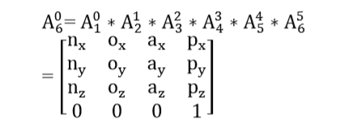
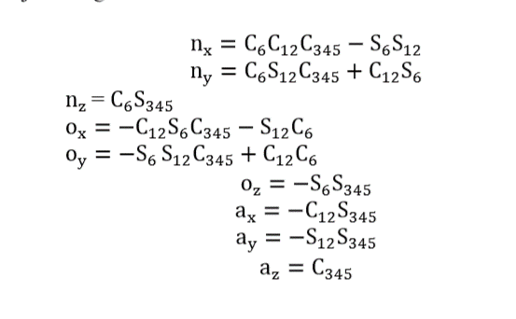
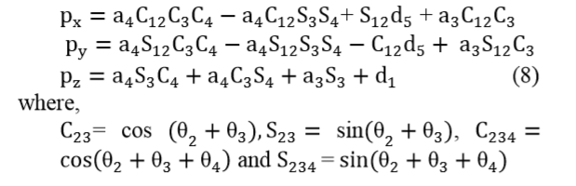
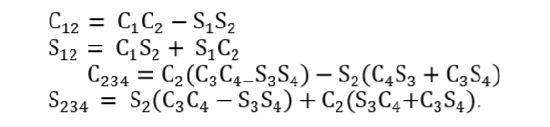
03
The technique
where, R is a 3×3 matrix for rotation and P is the position, so the total matrix of transformation:
where, p/,p2, p3 represent the position and {(n/, n2, n3), (o/, o2, o3), (a/, a2, a3}, represent the orientation of the end- effector, they can be calculated in terms of joint angles:
Making use of some trigonometric equations helps for easy solutions:

Slide 9

03
The technique- Inverse kinematics
FORWARD KINEMATICS
The joint variables of the robot are given to determine the position and orientation effector.
Assignments of joints and all parameters used to define the robot frames can be defined by using the DH parameters table explained by Tahseen (2013)
The solution of Inverse kinematics is more complex than forward kinematics and there is many solutions approach such as geometric and algebraic analysis used for finding the inverse kinematics considering the system structure of the robotic arm. In case of inverse kinematics the joint angles can be determined for any desired position and orientation in Cartesian space
Table 1 shows the related six joints parameters of the robotic arm ROB0036 manipulator in order to find the position and orientation of the rigid body which is useful for obtaining the composition of coordinate transformations
The matrix manipulations has resulted the following matrix solutions:

Slide 10
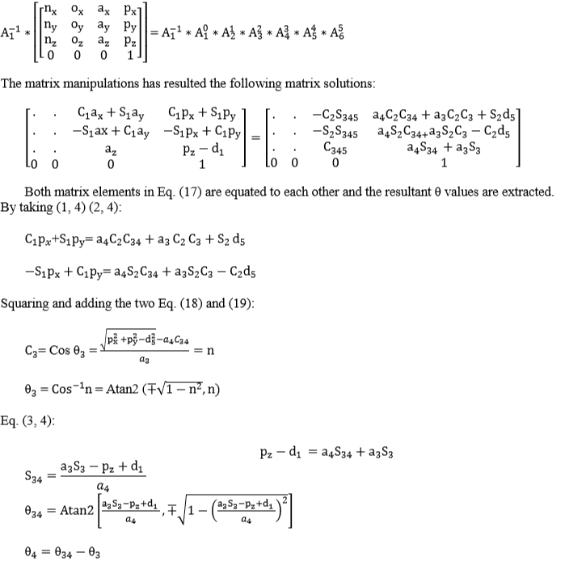
03
The technique
FORWARD KINEMATICS
The joint variables of the robot are given to determine the position and orientation effector.
Assignments of joints and all parameters used to define the robot frames can be defined by using the DH parameters table explained by Tahseen (2013)
Table 1 shows the related six joints parameters of the robotic arm ROB0036 manipulator in order to find the position and orientation of the rigid body which is useful for obtaining the composition of coordinate transformations

Slide 11
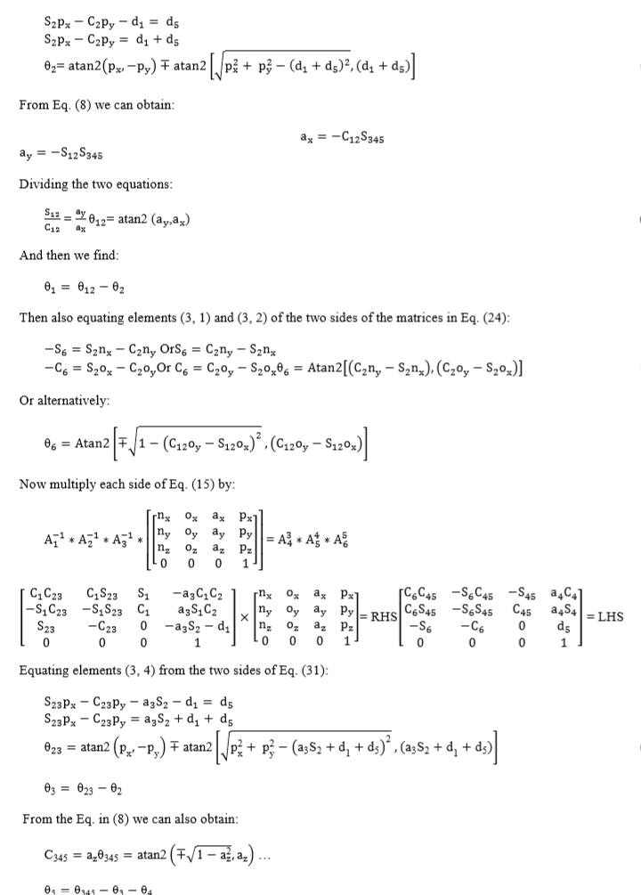
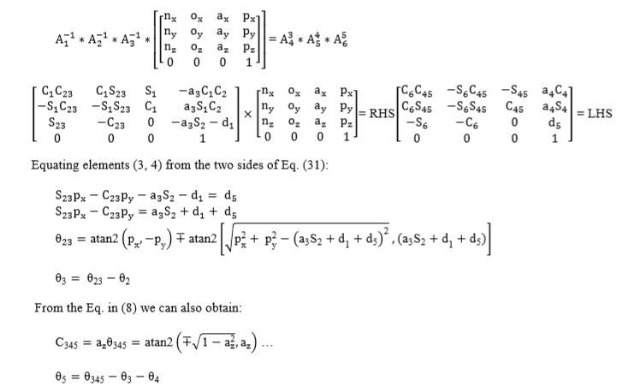
03
The technique- Inverse kinematics
FORWARD KINEMATICS
The joint variables of the robot are given to determine the position and orientation effector.
Assignments of joints and all parameters used to define the robot frames can be defined by using the DH parameters table explained by Tahseen (2013)
Table 1 shows the related six joints parameters of the robotic arm ROB0036 manipulator in order to find the position and orientation of the rigid body which is useful for obtaining the composition of coordinate transformations

Slide 12



References
-https://www.youtube.com/watch?v=sJmkb8UEW34
-https://www.user.tu-berlin.de/mtoussai/teaching/14-Robotics/02-kinematics.pdf
-Research Article Kinematics Analysis and Modeling of 6 Degree of Freedom Robotic Arm from DFROBOT
THANK YOU
You are Welcome To Contact Me
Mojahed-nour
@MJD_noor
Mojahed nour
Mojahednour@email.com

